Slide 1
Programming pradgism - Functional programming -
Vu Tuan Hai

Slide 2

1. Overview
Logo Haskell, which is inspired from Monad >>= (an abstract object in Haskell) and lambda λ

Slide 3
Overview
Haskell Stack
.hs
Hackage 1
Hackage 2
...
Sandbox
GHCi, Cabal
GHC
Haskell Language Server
Editor: VSCode, Sublime text
.o
Anaconda
.py
Package 1
Package 2
...
Virtualen
Python interactive, Pip
Compiler
Python Language Server
Editor: VSCode, Sublime text
.pyc

Slide 4
Notation
f, g, … : object, which is function (note that everything in Haskell are functionally)
a, b, …: parameter
F, A, M, Ord, Bool, …: abstract type

Slide 5
2. Basic

Slide 6
Basic: side effect
global numberOfSomething
def DoSomeThing(count):
numberOfSomething += 1
return count + 2
Side effect
makes referential transparency

Slide 7
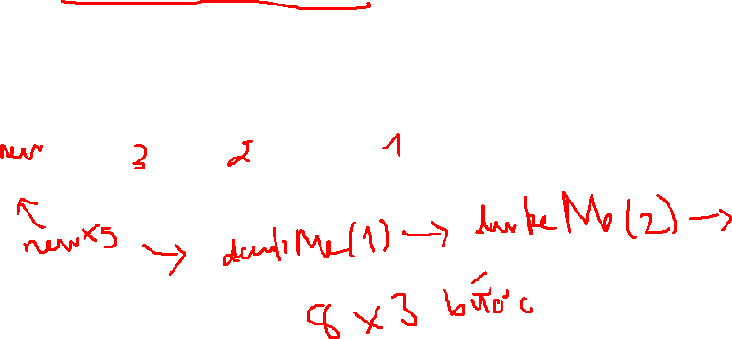
Basic: lazy evaluation
xs = [1, 2, 3, 4, 5, 6, 7, 8]
new_xs = doubleMe(doubleMe(doubleMe(xs)))
print( xs[0] )

Slide 8
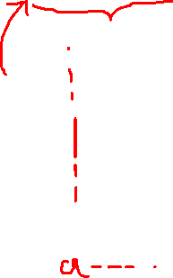
Basic: statically typed
a = 5 + 4
Compiler
“So a is integer”

Slide 9

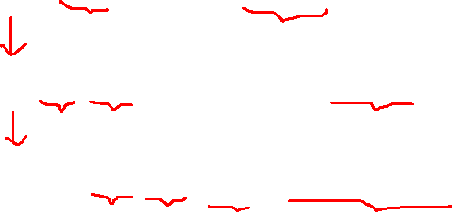
Basic: function
In math: $add\left(x,y\right)≔x+y$
In C++: int add (int x, int y) { return x + y };
In Python: def add (x, y): return x + y
In Haskell: add x y = x + y
Name
Parameter
Definition

Slide 10
Write your first function!
Write the function doubleMe that doubles anything you put into
Calculate: x^2 + y^2

Slide 11

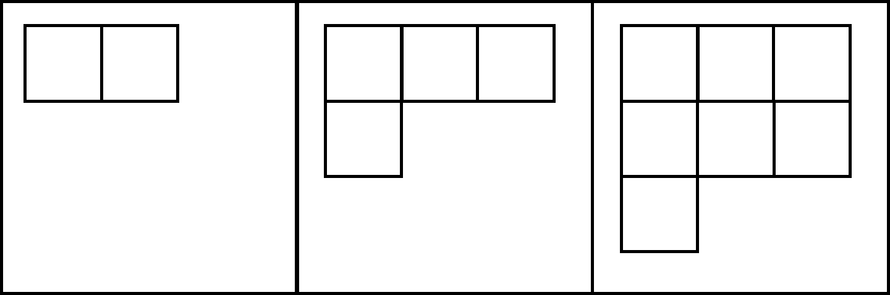
3. List

Slide 12
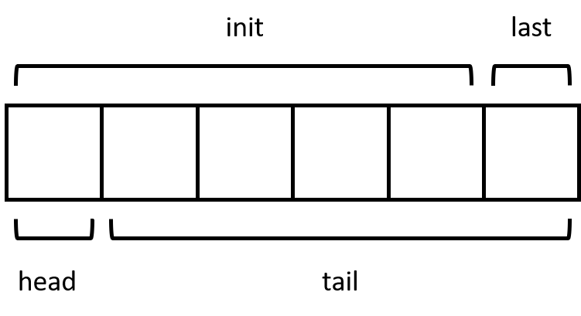
3. List

Slide 13
4. Special list: range
In Python:
range(0, 5) = [0, 1, 2, 3, 4]
In Haskell:
[0 .. 4] = [0, 1, 2, 3, 4]

Slide 14

4. List comprehension
In math:
$xs=\{2x|x∈ℕ,x≤10\}$
In Haskell:
xs = [x * 2 | x <- [1 .. 10]]

Slide 15
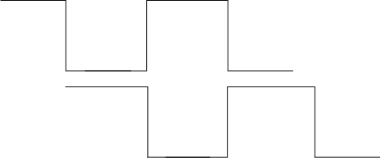
5. Tuple
person = ("Christopher", "Walken", 55).
Zip function:

Slide 16
Excercise
Find all triangles have integer sides and all sides are equal to or shorter than 10 and have a perimeter of 24.

